Slide 1

Building A Volunteer Marketing & Communications Committee
Joe Mueller
@jfmueller
muellercommunications-stl.com

Slide 2
Building A Volunteer Marketing & Communications Committee
  The Fundamentals (3 Ms):
  Fundraising (Money)
  Clients/Programs (Membership)
  Volunteers (Manpower)

Slide 3
Building A Volunteer Marketing & Communications Committee
Know Your Organization
  What is the mission?
  What are the expectations?
  What are the goals?

Slide 4
Building A Volunteer Marketing & Communications Committee
Evaluate The Organization’s Communications
  Talk with stakeholders
  Perform a communications audit
  Conduct a SWOT analysis

Slide 5
Building A Volunteer Marketing & Communications Committee
Develop an IMC Committee
(Integrated Marketing Communications)
  Communications Staff Need to become ‘Executive Producers, Editors’
  Become… ‘a jack of all trades and a master of none’

Slide 6
DBuilding A Volunteer Marketing & Communications Committee
IMC Committees Increase:
  Efficiency
  Activity
  Knowledge
  Distribution of work

Slide 7
Building A Volunteer Marketing & Communications Committee
Functions of an IMC Committee:
  Develop, implement and evaluate the plan
  Identify, communicate trends
  Communicate to audiences

Slide 8
Building A Volunteer Marketing & Communications Committee
Functions of an IMC Committee (Continued):
  Support delivery of organization’s program
  Promote positive public relations
  Promote new programs, projects

Slide 9
Building A Volunteer Marketing & Communications Committee
Functions of an IMC Committee (Continued):
  Ensure creation of consistent messages
  Produce content (publications, video, audio)
  Conduct, analyze and utilize research

Slide 10
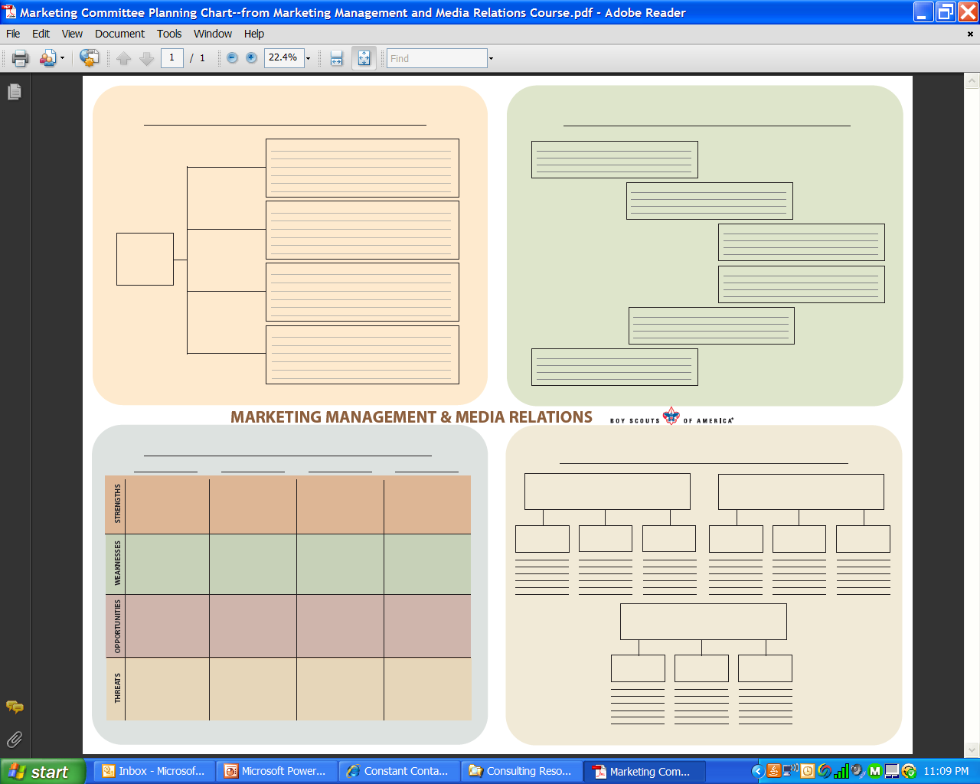
www.jfmueller.com

Slide 11
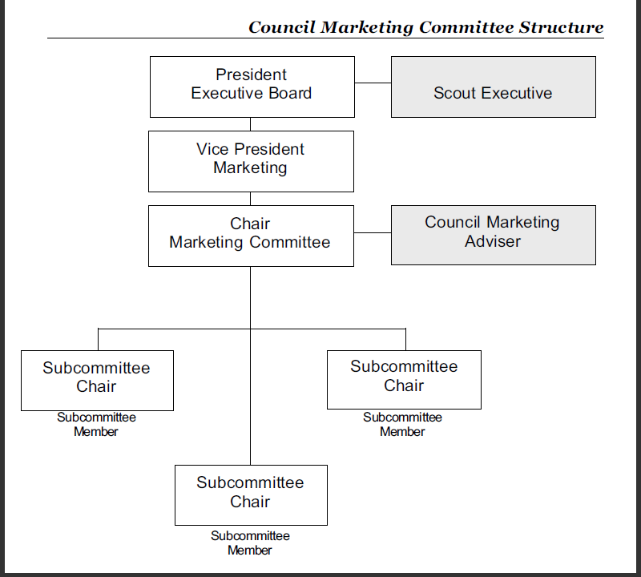
www.jfmueller.com

Slide 12
Building A Volunteer Marketing & Communications Committee
Where to look for IMC Committee members:
  Local college, university marketing/business departments
  Ad agencies, PR firms
  AMA (American Marketing Assoc.), PRSA (Public Relations Society of America)

Slide 13
Building A Volunteer Marketing & Communications Committee
Where to look for IMC Committee members (Continued):
  Billboard companies
  Corporate marketing, advertising, graphic design companies
  Freelance writers, designers, photographers
  Media companies

Slide 14
Building A Volunteer Marketing & Communications Committee
Where to look for IMC Committee members (Continued):
  Companies with large advertising presence
  School district communications, public relations coordinators

Slide 15
Tom Thompson
VP of
Media World
Mission for Margin Marketing & Communications Committee
Cindy, Owner of Web Solutions
Tim, Production Mgr. KWMU-TV
John,
CEO of
WOM
P.R.
Ella, VP of Rather Marketing
Greg, Freelance Graphic Design

Slide 16
Building A Volunteer Marketing & Communications Committee
Communications Audit:
  What is the organization’s mission?
  Who are your target audiences?
  How do your audiences perceive your organization?
  What are your strengths?

Slide 17
Building A Volunteer Marketing & Communications Committee
Communications Audit (Continued):
  What is the most common and most significant complaint your organization receives?
  Where are your opportunities?
  What is threatening your organization?

Slide 18
Building A Volunteer Marketing & Communications Committee
Communications Audit (Continued):
  What kind of customer service do you provide?
  How well does your organization communicate with internal audiences?
  External audiences?

Slide 19
Membership
Programs
Recruitment
Fundraising

Slide 20
Objectives
Increase clients
Improve Awareness Of Prevention Programs
Assist upcoming capital campaign for new facility
Increase participation in volunteer training
Increase individual
donations
Establish awareness of endowment fund

Slide 21
Marketing & Communications Plan
Increase participation in volunteer training
Increase individual donations
Newsletter
Article
Video
Social
Media
Brochure
Blog
Direct Mail
Increase client services
  Advocacy
Op-Ed Article
Media Relations

Slide 22
Building A Volunteer Marketing & Communications Committee
Planning, Writing THE PLAN
  Six elements:
    Executive Summary
    Situation Analysis
    Marketing Strategy
    Marketing Objectives
    Action Plan and Implementation
    Evaluation

Slide 23
Building A Volunteer Marketing & Communications Committee
Executive Summary
  Brief review of entire marketing/communications plan
  Includes background information on organization
  Best to write last and after details are finalized

Slide 24
Building A Volunteer Marketing & Communications Committee
Situation Analysis
  Target market
  Demographics
  Competitors, landscape
  Sets stage for strategies and objectives

Slide 25
Building A Volunteer Marketing & Communications Committee
Marketing Objective
  Overall goal of what organization wants to accomplish
  Overarching goal
  What are we striving to be?
  SAMPLE OBJECTIVE: To become the one-stop source for all family health, fitness and recreation opportunities.

Slide 26
Building A Volunteer Marketing & Communications Committee
Marketing Strategies
  What conditions must exist to achieve organizational goal?
  SAMPLE STRATEGY: Five impressions on parents between New Year’s Eve and March 1 with message on becoming members.

Slide 27
Building A Volunteer Marketing & Communications Committee
Tactics
  How will you achieve strategies?
  Detailed activities
  What, how will you execute tactics?

Slide 28
Building A Volunteer Marketing & Communications Committee
Requirements For Effective Tactics
  Do we have the budget?
  Can we meet schedule, time commitments?
  Do we have all available resources to be successful?
  Will this tactic meet our needs?

Slide 29
Building A Volunteer Marketing & Communications Committee
SAMPLE TACTICS:
  Media release twice per month that features fitness success story
  Print, Facebook ads on discounted membership fee
  Billboards positioned within 5 miles of facility
  Direct-mail postcard delivered on Dec. 31 that outlines discounted membership fee

Slide 30
Building A Volunteer Marketing & Communications Committee
Implementation:
  Confirm, track costs
  Clarify responsibilities
  Establish schedule, meet deadlines

Slide 31
Building A Volunteer Marketing & Communications Committee
Evaluation:
  Review the measurable element for each goal
  Use inexpensive online research tools (Survey Monkey)
  Seek feedback from stakeholders

Slide 32
Building A Volunteer Marketing & Communications Committee
Celebrate Success
  Share results with staff, volunteers, board
  Earn, maintain ‘seat at the table’

Slide 33
Building A Volunteer Marketing & Communications Committee
Rewrite, Refine Plan
  Utilize feedback from evaluation
  Be more creative, innovative
  Recruit more talent, resources

Slide 34
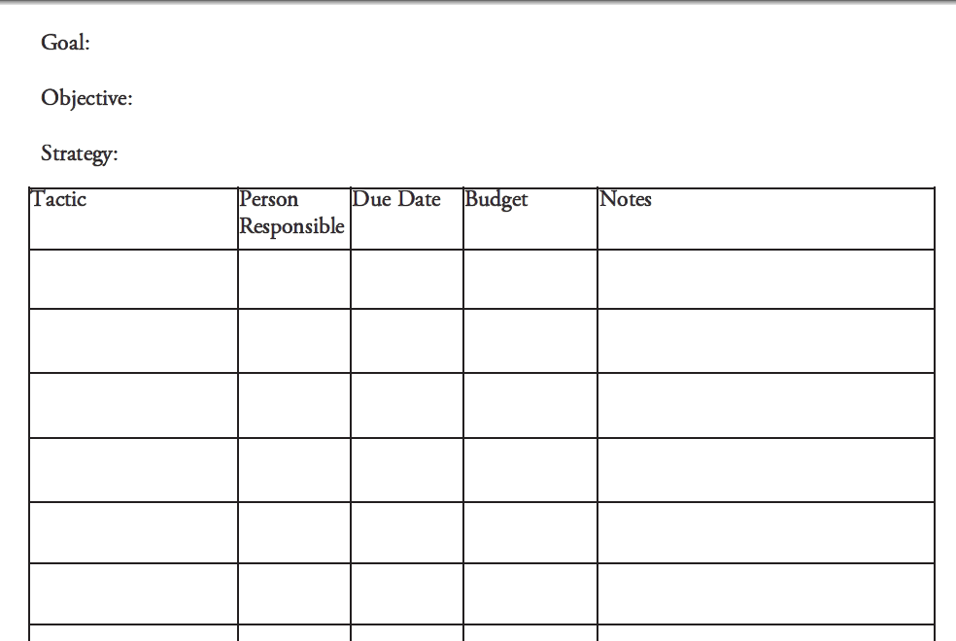

Slide 35
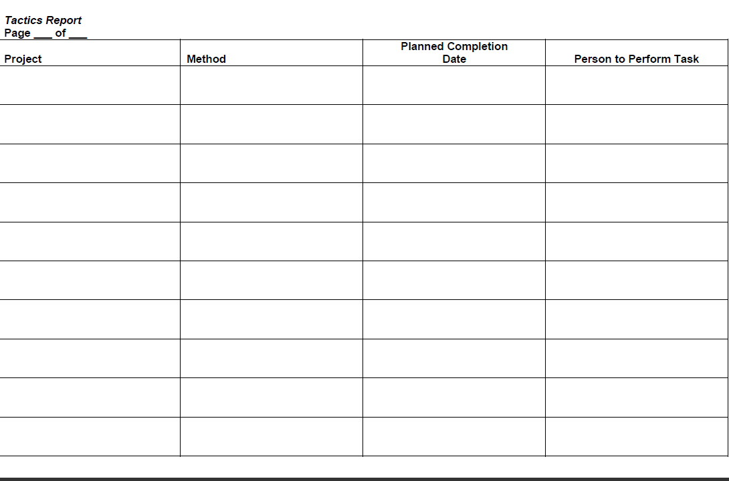

Slide 36
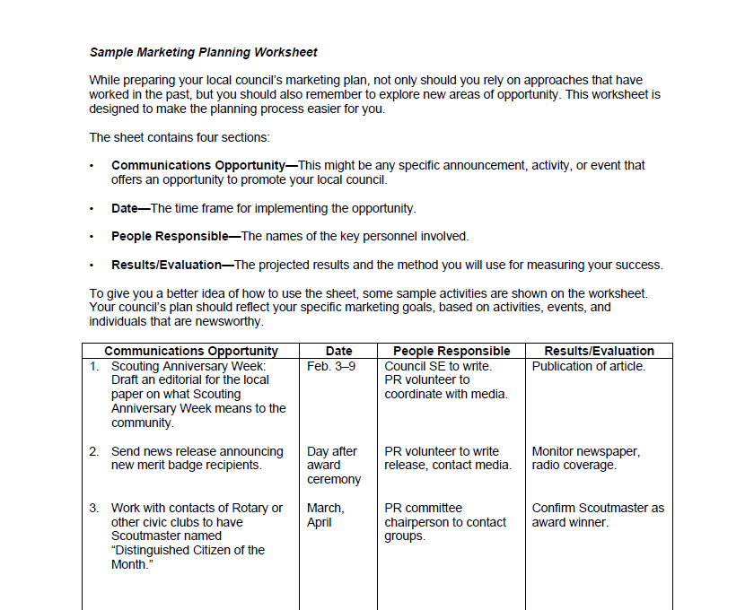

Slide 37
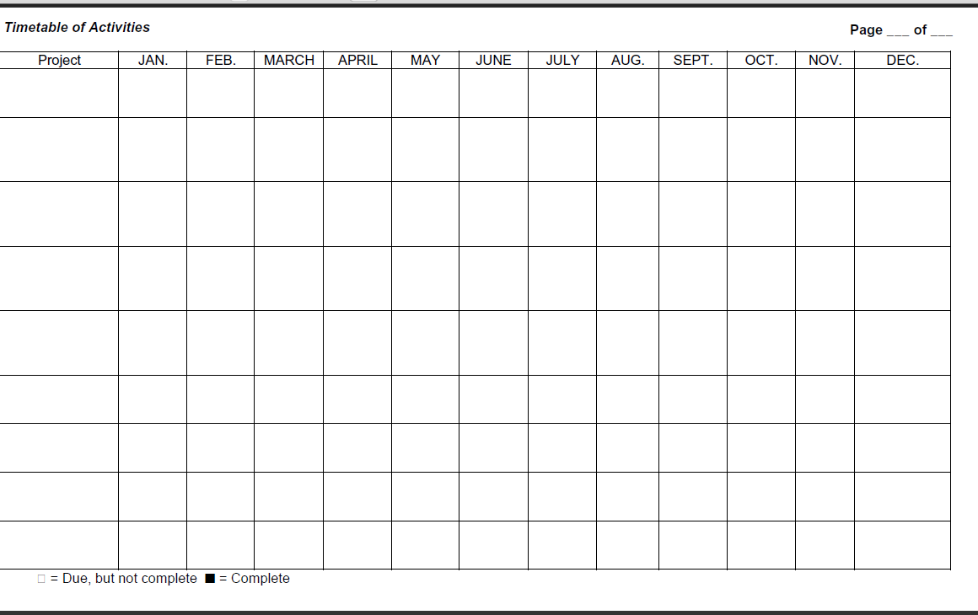

Slide 38
Building A Volunteer Marketing & Communications Committee
The Plan is the SKELETON…
…but your communications must touch the HEART…

Slide 39
Building A Volunteer Marketing & Communications Committee
Be a GOOD STORYTELLER…
GOOD WRITING is EVERYTHING!

Slide 40
Building A Volunteer Marketing & Communications Committee
  Joe Mueller,
  Principal
  Mueller Communications
  muellercommunications-stl.com
  Blog: www.thestrategiccommunicator.com
  E-mail: joe@muellercommunications-stl.com
  Twitter: @jfmueller

